Slide 1
Digital Angel
Workshops

Slide 2
Workshops
Digital Angel MVP Requirements
  Understanding the high level requirements
  Defining the Customer User Stories (Product Owner)
  Defining Technical User Stories (Solution Architect)
Day-1: 21.May.2020 (Thursday)
  12:00 – 13:00 Session-1 (Requirements, Reference Architecture)
  14:00 – 15:00 Session-2 (Identify Stories)
Day-2: 22.May.2020 (Friday)
  10:00 – 11:00 Session-1 (Product Backlog – Write stories)
  14:00 – 15:00 Session-2 (Product Backlog – Write stories)

Slide 3
Guidelines to design/analyze features
Define a legend
  Representing a Database
  Representing a role/user
  Representing reports
  Representing telemetry data
  Representing relationships
  Describing the lines
Every feature must have inputs, process, output and role
Every feature must be simple and capture the minimum scope for the feature

Slide 4
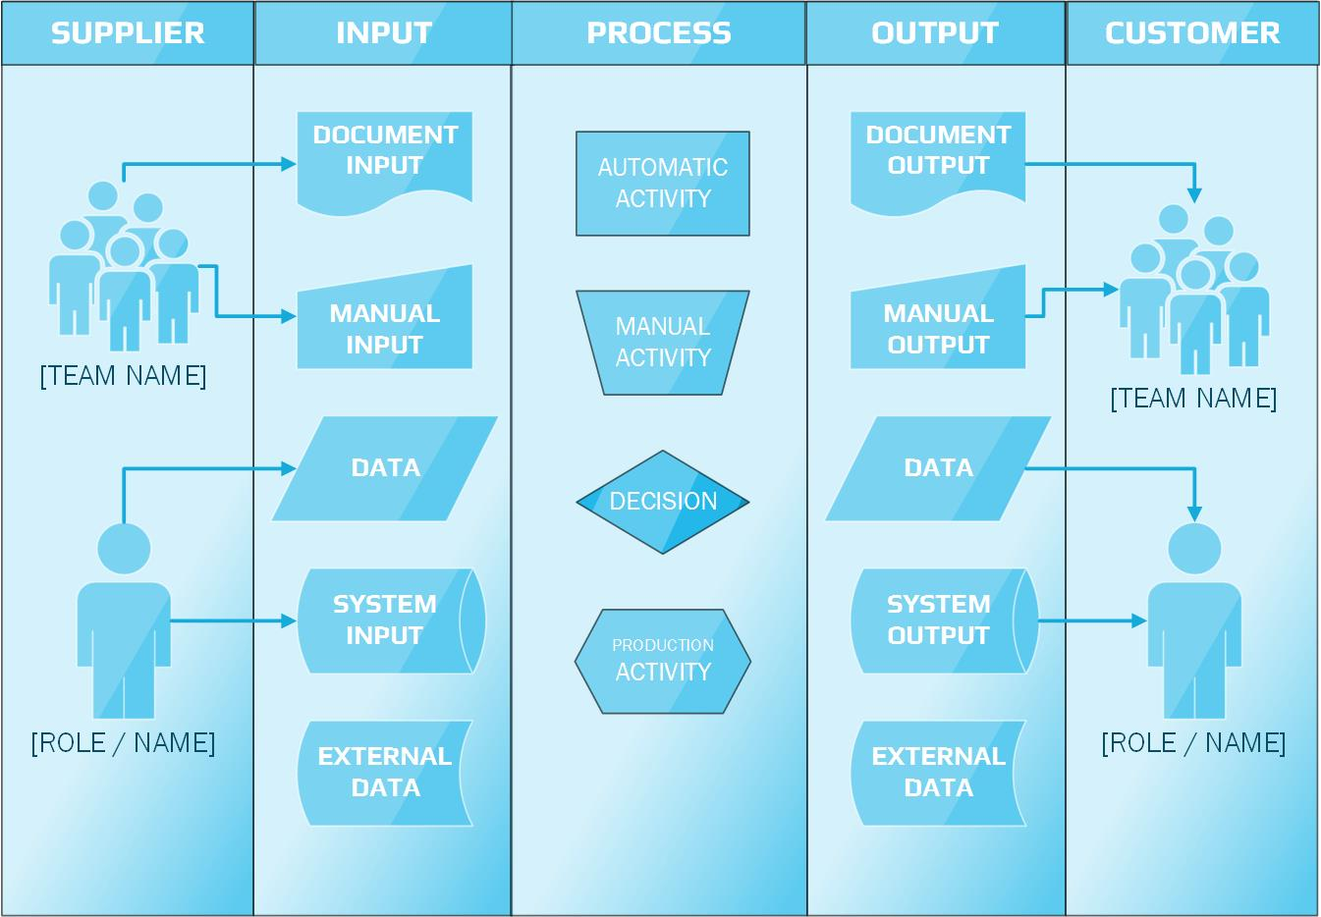

Slide 5
Scope of Minimum Viable Product (MVP)
Inputs provided by Deak
1. Ability to upload/track/enter mattress and sensor information
2. Ability to assign mattress to an entity (room/patient)
3. Ability to track patients
4. Creation of a Nurse/Caregiver community to view patient activity
5. Integration/canvas with smart mattress with visual of weight movement
6. Ability to create reports based off real time data
7. Ability to create/modify alerts based off real time data
8. Ability to manage Org users/licenses
9. Ability to assign patients to a Nurse/Caregiver
10. Must have ability to be HIPPA compliant (discuss further)
11. Architecture must allow for multiple locations for one customer
12. Must have multiple and modifiable role-based structure
13. Should be mobile ready
14. Must have ability to track patient/caregiver interaction

Slide 6
Feature: Ability to upload/track/enter mattress and sensor information
Excel/CSV/JSON
Script
Sensor DB
Patient information
UI
SQL
Script
Ability to upload/track/enter mattress and sensor information
Upload Mattress and Sensor information
Track the mattress and sensor
When it is assigned to a patient
Enter Mattress and Sensor information
When it is NOT assigned to a patient
When it is assigned and then found to be not operational
When it is not operational
When it is in the store
Mattress DB

Slide 7
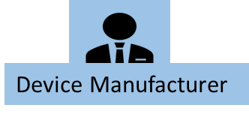


Feature: Ability to upload/track/enter mattress and sensor information
Supplier
Input
Script
Process
Output
Customer
UI
SQL
Device Metadata
(CSV/Excel/JSON)
Upload Mattress and Sensor information
Device DB
Enter Mattress and Sensor information
Device Metadata
(Manual Entry)
Patient DB
Device DB
Track the mattress and sensor
Device DB
Room
DB
Tracking Report

Slide 8
Feature: Ability to assign mattress to an entity (room/patient)
Scripts
Patient –Mattress Assigned DB
Mattress DB
Alerts & Actions
Get Mattress ID
UI
SQL
Ability to assign mattress to an entity (room/patient)
Get Patient ID
Assign mattress to a Patient
Patient information
Patient DB
Assign mattress to a Room
Room Information
Room DB
Get Room ID

Slide 9


Feature: Ability to assign mattress to an entity (room/patient)
Supplier
Input
Process
Output
Customer
Script
UI
SQL
Assign mattress to a Patient
Mattress DB
Assign mattress to a Room
Patient –Mattress Assigned DB
Patient DB
Patient information
Room DB
Room Information
Alerts & Actions

Slide 10
Feature: Ability to track patient
Scripts
UI
SQL
Alerts
Health
Care DB
Ability to track Patients
Patient information
Patient DB
Patient_id
In Patient
Remote patient
Reports

Slide 11


Feature: Ability to track patient
Supplier
Input
Process
Output
Customer
Script
Health
Care DB
UI
SQL
Patient information
Reports
Patient DB
Alerts & Actions

Slide 12
Feature: Creation of a Nurse/Caregiver community to view patient activity
Scripts
Nurse/Caregiver DB
Sensor Device Output images
UI
SQL
Creation of a Nurse/Caregiver community to view patient activity
Patient Tracker
Healthcare DB
Patient DB
Sensor Device Information

Slide 13




Feature: Creation of a Nurse/Caregiver community to view patient activity
Supplier
Input
Process
Output
Customer
Script
UI
SQL
Nurse/Caregiver DB
Nurse/Caregiver information
Patient ActivityTracker
Healthcare DB
Patient information
Patient DB

Slide 14
Feature: Integration/Canvas with Smart Mattress visual of Weight movement
Scripts
Patient DB
UI
SQL
Alerts & Actions
Patient_Id
Integration/Canvas with Smart Mattress visual of Weight movement
Sensor Information
Heat Map Visualization
Sensor DB
Reports
Mattress_Id
Mattress DB

Slide 15



Feature: Integration/Canvas with Smart Mattress visual of Weight movement
Supplier
Input
Process
Output
Customer
Script
Patient DB
UI
SQL
Sensor DB
Heat Map Visualization
Reports
Mattress DB
Alerts & Actions

Slide 16
Feature: Ability to create reports based off real time data
Patient DB
Scripts
UI
SQL
Ability to create reports based off real time data
Nurse/caregiver
Patients Experience on Medical condtion
Reports
Patient
Sensor Telemetry Data
Sensor DB

Slide 17

Feature: Ability to create reports based off real time data
Supplier
Input
Process
Output
Customer
Script
Patient Information
UI
SQL
Sensor Telemetry Data
Analytics
Reports
Patient DB
Sensor DB

Slide 18

Feature: Ability to create/modify alerts based off real time data
Scripts
Action takes place
Set of Rules/Instructions
?
Modified Patient DB
UI
SQL
Text/Mail
?
Ability to create/modify alerts based off real time data
Mattress DB
System Admin
Alerts
Send alert to Caregiver
Get Patient real time data
Get sensor real time data
Alert Log
Mobile Device
Patient DB
Sensor Device

Slide 19

Feature: Ability to create/modify alerts based off real time data
Supplier
Input
Process
Output
Customer
Set of Rules/Instructions
Script
Modified Patient DB
UI
SQL
Sensor Device Realtime Data
Triggers
Send alerts to Caregiver
Mattress DB
Alert Log
Patient DB
Sensor DB

Slide 20
Feature: Ability to manage Org User’s/Licenses
Scripts
Grant or restrict permissions
UI
SQL
Permissions Enable/Disable
Ability to manage Org users/licenses
Admin DB
ModifiedAdmin DB
User’s/Roles
Subscription
Licensing
Manage User’s
And Access

Slide 21


Feature: Ability to manage Org User’s/Licenses
Supplier
Input
Process
Output
Customer
Script
UI
SQL
Grant or restrict permissions
Admin DB
ModifiedAdmin DB
Licensing
Manage User’s
And Access

Slide 22
Feature: Ability to assign patients to a Nurse/Caregiver
Room Information
Patient DB
Ability to assign patients to a Nurse/Caregiver
Patient_Id
ModifiedPatient DB
Nurse manger
Nurse_Id
Caregiver_Id
Assign Nurse to a Patient
Assign Caregiver to a Patient
Nurse/Caregiver information

Slide 23

Feature: Ability to assign patients to a Nurse/Caregiver
Supplier
Input
Process
Output
Customer
Room Information
Rules Applied
Modified Patient DB
Nurse/Caregiver information
Patient DB
Assign Nurse to a Patient
Room DB
Assign Caregiver to a Patient

Slide 24
Feature: Ability to be HIPAA compliant
Ability to be HIPAA compliant

Slide 25
Feature: Ability to be HIPAA compliant
Supplier
Input
Process
Output
Customer

Slide 26
Feature: Architecture must allow for multiple locations for one customer
Architecture must allow for multiple locations for one customer
Updated
Patient DB
ORG
BLOCK-A
BLOCK-B
Patient Information
Room-1
Room-2
Patient DB

Slide 27


Feature: Architecture must allow for multiple locations for one customer
Supplier
Input
Process
Output
Customer
Patient Information
ORG
Designing Architecture
Block-A
Room
Patient DB

Slide 28

Feature: Must have multiple and modifiable role-based structure
Admin DB
CRUD Functionalities
Modified Nurse/Caregiver DB
Modify/alter
Nurse/Caregiver Roles
Update
System Admin
Must have multiple and modifiable role-based structure
Role_Id
Nurse Manager
Nurse_Id
Modified Admin DB
Modify/alter
System Roles
Update
Nurse/Caregiver DB

Slide 29




Feature: Must have multiple and modifiable role-based structure
Supplier
Input
Process
Output
Customer
Modify/alter
Nurse/Caregiver Roles
Modified Admin DB
Admin DB
Caregiver DB
Modified Nurse/Caregiver DB
Modify/alter
System Roles

Slide 30


Feature: Should be mobile ready
Users
Should be mobile ready
App Access
System Admin
App Access
Community
Access
App Access
Product Owner

Slide 31




Feature: Should be mobile ready
Supplier
Input
Process
Output
Customer
Access
App Access
Mobile Access Ready

Slide 32
Feature: Must have ability to track patient/Caregiver interaction
Patient information
Must have ability to track patient/caregiver interaction
Patient_Id
Tracking
Chatter
Nurse/caregiver information
alert/text history

Slide 33

Feature: Must have ability to track patient/Caregiver interaction
Supplier
Input
Process
Output
Customer
Chatter
Patient Information
Tracking
Nurse/Caregiver Information
Alert/Text History

Slide 34
Title | Description
 | Patient Database Patient Metadata (e.g., Patient-ID, Patient Name, Patient Address, Patient Contact Information……) Patient Status (e.g., In-Patient , Remote Patient.)
 | Device Database Device Metadata ( e.g., Device-ID , Device Name , Type of Device …)
 | Room Database Room Information ( e.g., Block Name , Floor no, Room No…
 | Mattress Database Mattress Information (e.g., mattress-ID, Mattress manufacturer , Date of Manufacture…
 | Patient-mattress assigned Database
Patient DB
Device DB
Room
DB
Mattress DB
Patient –Mattress Assigned DB

Slide 35
Title | Description
 | Sensor Database
 | Admin Database
 | Modified Admin Database
 | Modified Patient Database
 | Upload Patient Database
Sensor DB
Admin
DB
Modified Admin DB
Modified Patient DB
Upload
Patient DB

Slide 36
Title | Description
 | HealthCare Database HealthCare Metadata (e.g., HealthCare Name, Address, Email, Phone, Services…) Staff Data (e.g., Doctors, Nurses, Caregivers, Admin and Accounting) Patient Database Device Database (Mattress, Sensor Information)
 | Caregiver Database
 | Modified Nurse/Caregiver Database
HealthCare DB
CaregiverDB
Modified Nurse/Caregiver DB

Slide 37
User/Roles | Description
Device Manufacturer | Who manufactures the device
Digital Angel Admin | Who handles the complete digital angel
Doctors | Who work for care and safety of patients. If they are ill or sick.
Nurse/Care Giver | Who are taking care of patients by doctor’s advice
Customer | Who uses the product (End user)
Digital Angel Users | Who already uses the digital angel product
Community | The group of people who already the part of digital angel
Product Owner | Who owns the Product

Slide 38


